Slide 1
Consider The Poor
Social media strategy and status

Slide 2
Consider the Poor Social Media Strategy
Focus is currently on Twitter
Finding and engaging with existing organizations that have a strong Twitter presence
Using Google news alerts to find interesting content to share

Slide 3
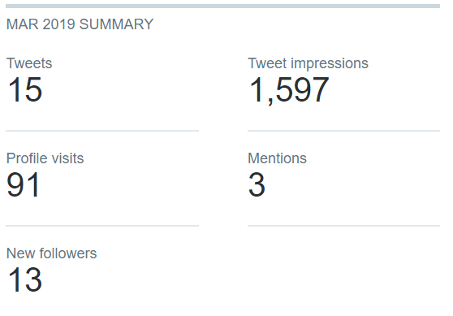
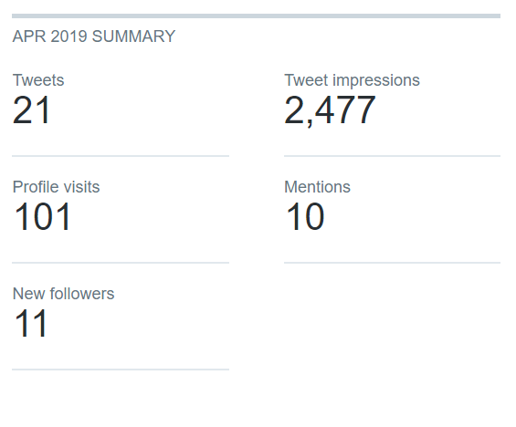
Consider the Poor Twitter Statistics

Slide 4
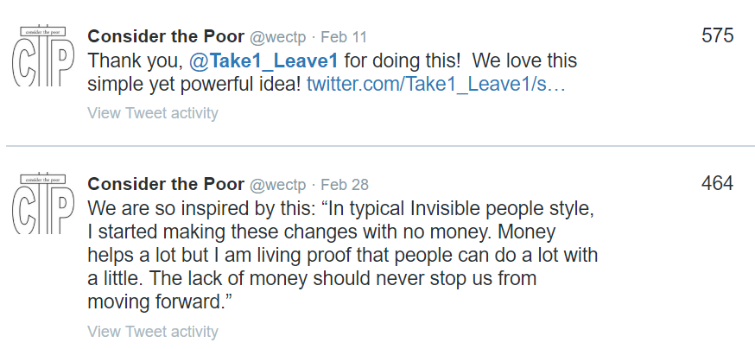
Consider the Poor – Top Tweets

Slide 5
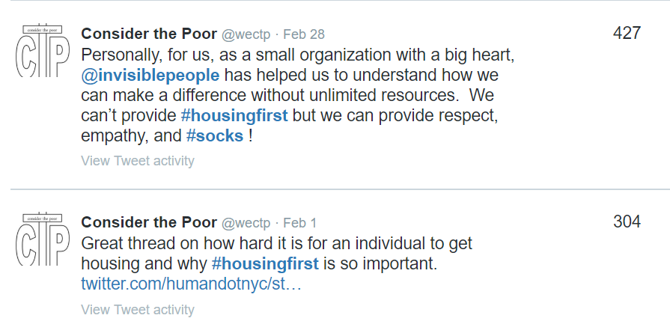
Consider the Poor – Top Tweets

Slide 6
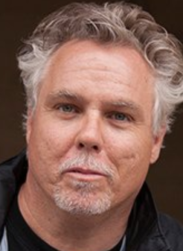
In the Spotlight – invisiblepeople.tv
Invisiblepeople.tv
Started by Mark Horvath on a $45 budget
Interviews homeless all around the world
Now has 261,000 YouTube subscribers and over 52 million views!
Stories from Columbus:
https://invisiblepeople.tv/category/by-location/columbus/

Slide 7
Consider the Poor Social Media Strategy
Next Steps:
Start to engage more on Facebook
Facebook is much better for longer content, i.e. “stories”
Facebook can drive Twitter traffic and vice-versa
Develop longer article-type content and video
Consider other platforms (Instagram, Snapchat, LinkedIn)

